Slide 1
Time Series Data Chapter 1
CS 637, St. Elizabeth's University, Fall 2021

Slide 2
Understanding Time Series Data
Definition
Time series are analyzed to understand the past and to predict the future, enabling modelers and stakeholders to make properly informed decisions.

Slide 3


Understanding Time Series Data Example
Gas suppliers in the United Kingdom have to place orders for gas from the offshore fields one day ahead of the supply. Variation about the average for the time of year depends on temperature and, to some extent, the wind speed. Time series analysis is used to forecast demand from the seasonal average with adjustments based on one-day-ahead weather forecasts.

Slide 4
Understanding Time Series Data Time Series
Variables measured sequentially over time
Interest rates
Exchange rates
GDP
Temperatures
Rainfall
Many, many more…
When these variables are measured sequentially over time, or at fixed intervals, we call the resulting dataset a time series.

Slide 5
Understanding Time Series Data Time Series
Observations collected over a fixed time interval form a historical time series
These sequences of realizations of random variables is sometimes defined as discrete-time stochastic process (time series model)
Stochastic – Well described by a random probability distribution (family of random variables)
Random Variables – Variable whose values depend on outcome of a random phenomenon. This random phenomena is typically defined by a probability distribution. Thus, a random variable is a function who maps a from a sample space (set of all outcomes) to the real numbers

Slide 6
Understanding Time Series Data Time Series Features
Trends
Seasonal Variations
Correlation
Sequential data points tend to show a degree of correlation
Defined as autocorrelation
Fit a time series model based on historical data, use to predict future values
More about this methodology later on…
Aggregated by time period
By minute, hour, day, month, year

Slide 7
Lecture 1.RMarkdown
Time Series Data

Slide 8
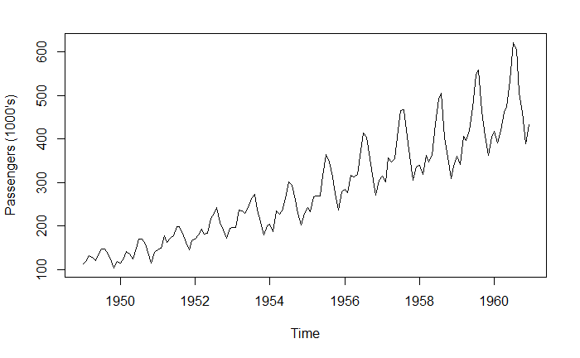
Understanding Time Series Data Time Series Plot
The number of passengers is increasing with time, although local variations may fluctuate
A systematic change that is not periodic (repeating) is known as a trend
Repeating pattern within each period (here, the period is about 1 year) is known as seasonal variation
Cycles are sometimes defined as seasonal variations that do not depend on some fixed natural period

Slide 9
Understanding Time Series Data Time Series Plot
What are some possible causes for the overall increasing trend?
What are some possible causes for the seasonal variation?

Slide 10
Lecture 1.RMarkdown
Time Series Data

Slide 11
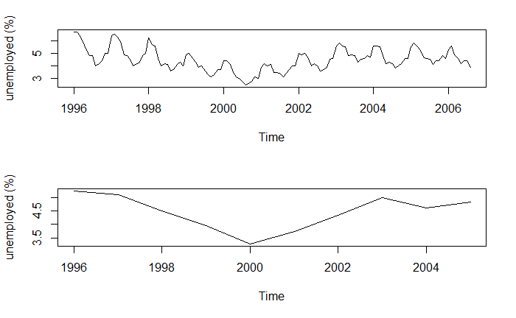
Understanding Time Series Data Time Series Plot
Which of the following plots describe the trend?
Which of the following plots describe the seasonal variation?

Slide 12
Understanding Time Series Data Time Series Plot
What are some possible explanations for the variation in seasonal trends?
[1] "February Ratio: 1.2225"
[1] "August Ratio: 0.8164"

Slide 13
Lecture 1.RMarkdown
Time Series Data

Slide 14
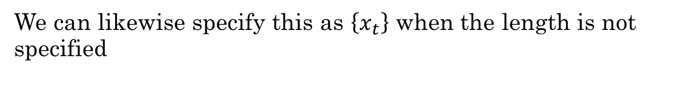
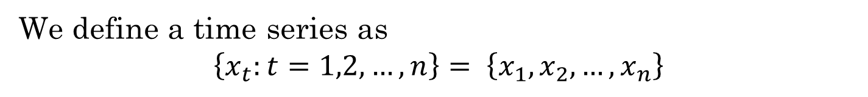
Understanding Time Series Data Decomposition of Series
We define a time series as
$$\left\{x_{t}:t=1,2,…,n\right\}= \left\{x_{1},x_{2},…,x_{n}\right\}$$
This is n values sampled at discrete times from 1 to n
We can likewise specify this as $\left\{x_{t}\right\}$ when the length is not specified
The time series model is a sequence of random variables, and the observed time series is considered a realization from the model.

Slide 15
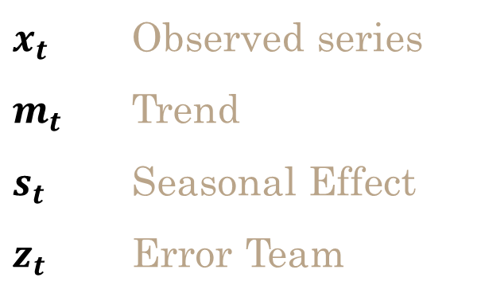
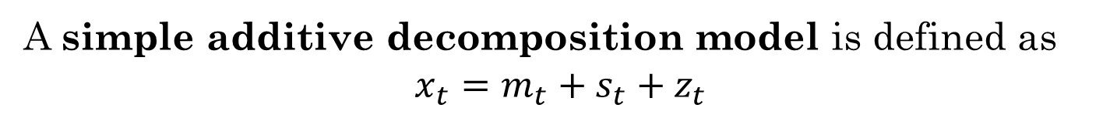
Understanding Time Series Data Decomposition of Series
A simple additive decomposition model is defined as
$$x_{t}=m_{t}+s_{t}+z_{t}$$
$x_{t}$ Observed series
$m_{t}$ Trend
$s_{t}$ Seasonal Effect
$z_{t}$ Error Team

Slide 16
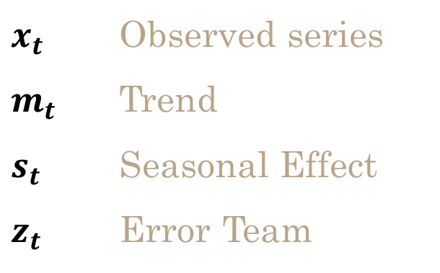
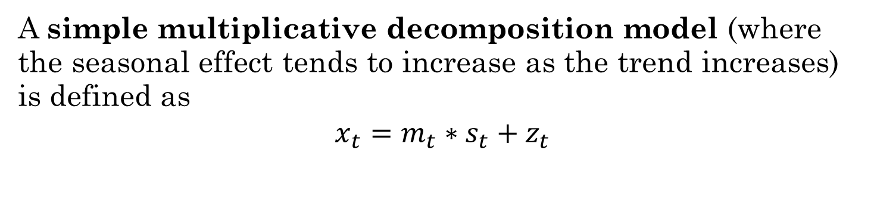
Understanding Time Series Data Decomposition of Series
A simple multiplicative decomposition model (where the seasonal effect tends to increase as the trend increases) is defined as
$$x_{t}=m_{t}∗s_{t}+z_{t}$$
$x_{t}$ Observed series
$m_{t}$ Trend
$s_{t}$ Seasonal Effect
$z_{t}$ Error Team

Slide 17
Understanding Time Series Data Decomposition of Series
A simple additive decomposition model is defined as
$$x_{t}=m_{t}+s_{t}+z_{t}$$
We can estimate the trend term using a moving average
A moving average is an average of a specified number of time series values around each value in the time series

Slide 18
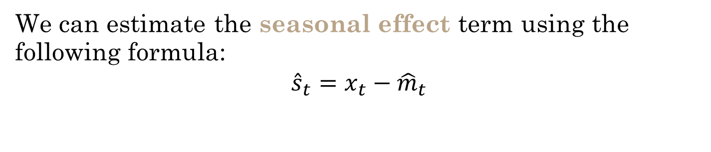
Understanding Time Series Data Decomposition of Series
A simple additive decomposition model is defined as
$$x_{t}=m_{t}+s_{t}+z_{t}$$
We can estimate the seasonal effect term using the following formula:
$${\hat{s}}_{t}=x_{t}−{\hat{m}}_{t}$$

Slide 19
Lecture 1.RMarkdown
Time Series Data

Slide 20
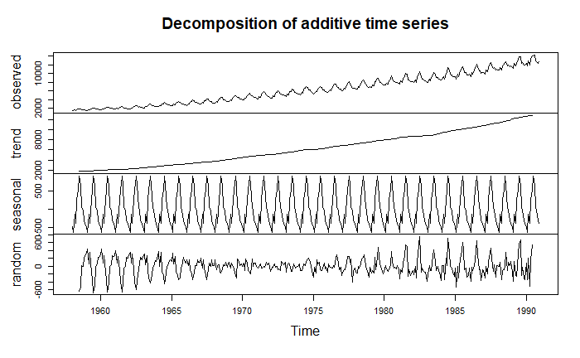
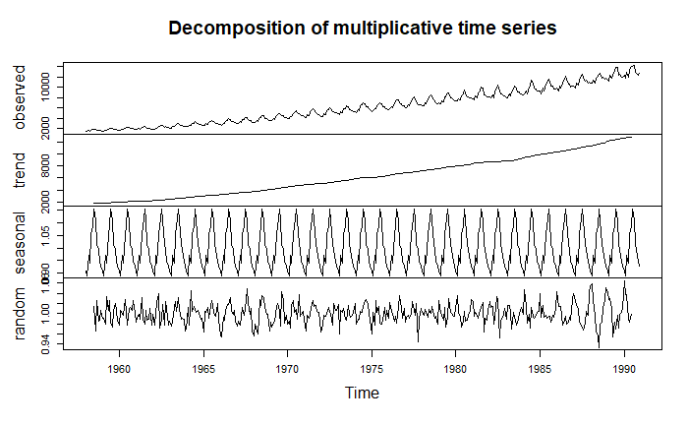
Understanding Time Series Data Decomposition of Series
Which decomposition seems most appropriate in this context?

Slide 21
Correlation Chapter 2
CS 637, St. Elizabeth's University, Fall 2021

